Slide 1

Artificial Intelligence & NEURAL NETWORKS - 20cys304
BOTNET HOST PREDICTION USING RNN
ARTIFICIAL INTELLIGENCE AND NEURAL NETWORKS – 20CYS304
TEAM 05:
ANIKET MISHRA – CH.EN.U4CYS20004
CHANDRAHAS ETIKALA – CH.EN.U4CYS20017
JAYANTA SIKDAR - CH.EN.U4CYS20031

Slide 2
TABLE OF CONTENTS
Overview
Introduction
Need for Research
Aims and Objectives
Existing Work and Research Gap
Dataset
Architecture Diagram
Data Preprocessing
Proposed Algorithm and Innovation
Walk through the Code.
Outputs and Results.
Conclusion
Bibliography
DATA SET CAN BE FOUND HERE

Slide 3

Introduction
WHAT IS COMPUTER NETWORK TRAFFIC ANALYSIS ??
Set of computers sharing resources.
Refers to the amount of data moving across a network.
WHAT IS BOTNET & BOTNET HOST??
Network of interconnected devices.
Infected by one or many known or unknown sources.

Slide 4
BOTNET HOST PREDICTION
Many hosts in a network
Sharing of multiple resources
Multipoint communication
One infected
May infect others
Steal private data and others
Hence, predicting such a host on a network and then eliminating it for security purposes comes with the task of BOTNET HOST PREDICTION

Slide 5
AIMS & OBJECITVES
Observe the network traffic and analyze it. Monitor the expected flow of each host from multiple hosts. Use RNN as the neural network technique and develop an algorithm
Propose a well-structured architecture diagram and understand the working of RNN and network traffic analysis.
Challenge the Classical ML technique against neural networks. Compute the results and plots for entropy and decide for each host based on randomness and disorder. Conclude with outcomes.

Slide 6
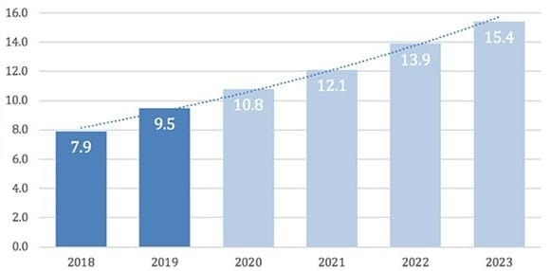
NEED FOR RESEARCH
Botnets have been significant threat in all areas.
They exploit vulnerability hence need to stop.
To distinguish between Trudy Attacker and legitimate host for ease of communication in multi host systems.

Slide 7
Existing Work
A wide range of research was carried out to detect botnet traffic with the help of the following algos:
LSTMs
Random Forest
Support Vector Machine
Their solution consists of two basic components:
Protocol classifier
Communication traffic pattern interpreters

Slide 8
Existing Methods and Their Results
REFERRED PAPER | DATASET | METHOD | TRAIN | TEST | ACCURACY | RECALL | PRECISION | F1-SCORE
Mitsuhiro Hatada, Matthew Scholl, et al. “An empirical study on flow- based botnet attacks prediction” | The overall dataset had 324 693 data points for approx 10 months | LSTMs | 29420 | 2140 | 76.7 % | 83.3 % | 73.6 % | 78.1 %
 |  | Random Forest | 6400 | 560 | 74.5 % | 82 % | 71.2 % | 76.5 %
 |  | Support Vector Machine | 2750 | 290 | 71.5 % | 76.9 % | 69.2 % | 72.8 %

Slide 9
Research Gap
There are two weaknesses with this kind of approach:
It can yield high rates of false.
Overhead of knowing what constitutes the normal behavior and what does not.

Slide 10
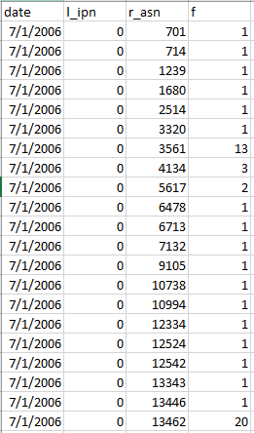
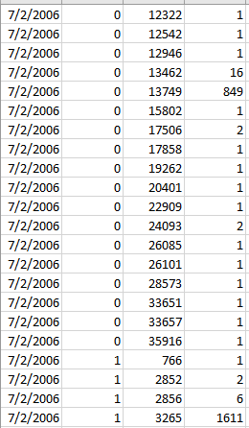
DATASET USED
Computer Network Traffic is with summary of some real network traffic data from the past.
The dataset has ~21K rows and covers 10 local workstation IPs over a three-month period.

Slide 11
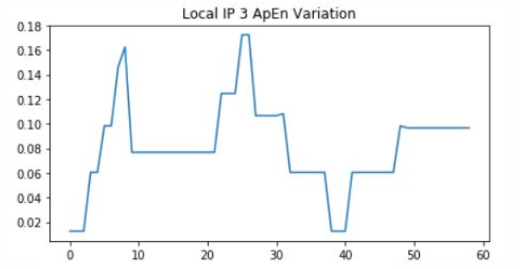
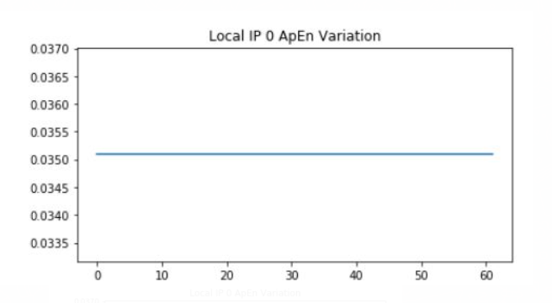
ARCHITECTURE DIAGRAM
DATA INPUT
Create_Dataset
Preprocessing and Plotting
Train the model using GRU
Predict the flow
Normalize the data
Higher ApEN -> More irregular series -> More randomness -> Botnet
Preprocessing by
3 functions
Approx. Entropy Plot

Slide 12
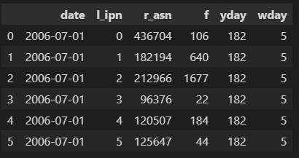
DATA PREPROCESSING
Number IP form 0-9 for different hosts depicting Local Flow.
Calculate the total flow of the day from each station.
Group the flow of each host together.
Group the flow according to yday i.e. day of the year.
Group the flow according to wday i.e. day of the week.

Slide 13
PROPOSED ALGORITHM
Considering the issues with classical ML techniques, we propose to use Recurrent Neural Network (RNN) as the new approach for a number of reasons:
Neural Networks perform better because of intense training from multiple hidden layers.
Our Dataset as discussed comprises of network traffic analyzed for n days.
RNN is based on inputs from previous layers and using recursion as its base technique.
The analogy thus is very suitable.

Slide 14
PROPOSED ALGORITHM
Time Series input is Fed to RNN & GRU is used to take input from previous hidden states as vectors.
For each gate, calculate the parameterized current input using Hadamard Product.
Apply the respective activation function for each gate element.
Model base: Sequential (time series)
Optimizer: Stochastic Gradient Descent (sgd)
Loss Function: Mean_squared_loss
Activation Function: tanh
Epochs: 100
Batch size: 16
Layers: Dense (o/p space 1)

Slide 15
IMPLEMENTATION
WALK THROUGH THE CODE

Slide 16
OUTPUTS
entropy curve has high randomness showcasing that the accuracy is low and that its more likely to be botnet.
randomness is almost 0, hence its predicting that is not a botnet and an actual host.

Slide 17
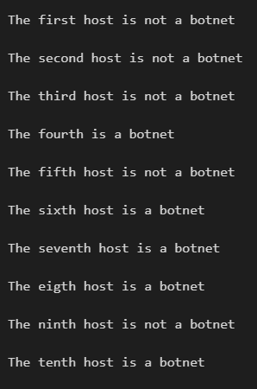
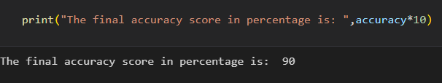
OUTPUTS

Slide 18
COMPARISON
Classical ML Techniques
Compare & Conclude
Make a comparison between all the approaches to conclude with the better one and then work on a research paper with this project.
Record Accuracy of the models based on previous research collected from different papers and use them for comparison.
New Approach – RNN
Use the new approach and train the model accordingly and use it compute the results classifying botnets against actual hosts.

Slide 19
CONCLUSION
Botnet Host prediction is really important in real time to block Trudy attackers.
The classical ML don't serve as required as obtained from literature surveys.
RNN(GRU) works the best until now by giving us the graphs.
The entropy graphs are easy to understand.
We further propose to publish a paper on the same, as our work we consider is novel.

Slide 20
BIBLIOGRAPHY
Hybrid Botnet Detection Based Host and Network Analysis
https://nvlpubs.nist.gov/nistpubs/TechnicalNotes/NIST.TN.2111.pdf
https://en.wikipedia.org/wiki/Approximate_entropy.
Measuring Botnets in Wild Nets, Paper by: Writan Chang
Bontet Host Analysis, review paper by Manas Kurtan Jena
JavatPoint and Stack Overflow for code error referrals.

Slide 21
THANK – YOU TEAM - 05

